Slide 1
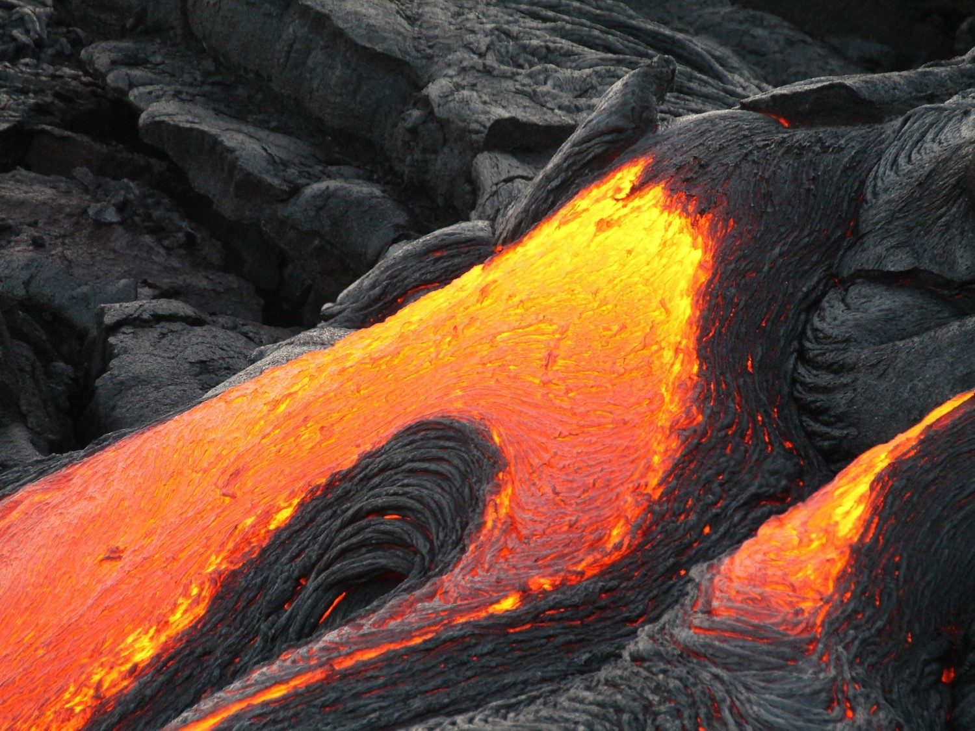

Structure of the Earth
How much do you know?

Slide 2
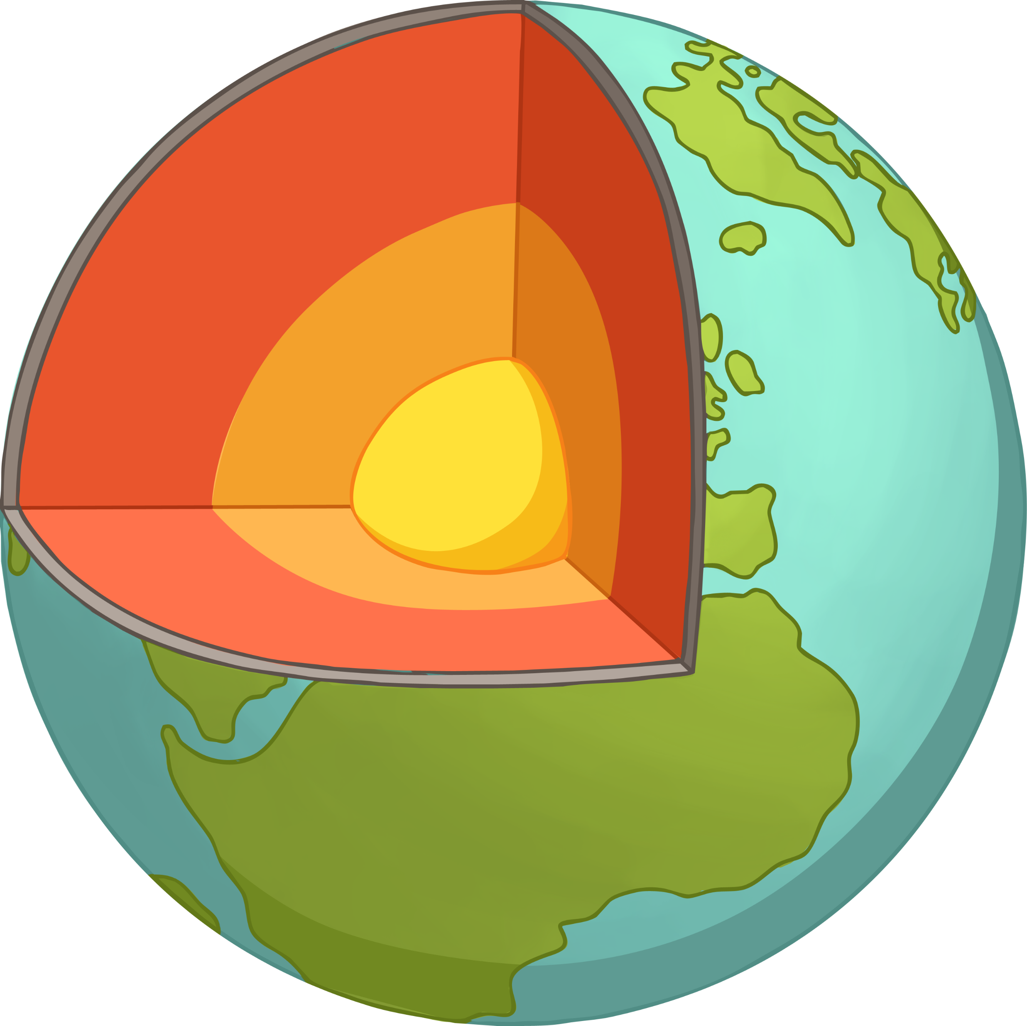








Question 1
A
B
C
What part of the Earth is A?
D
twinkl.com

Slide 3








Question 2
A
B
C
What part of the Earth is B?
D
twinkl.com

Slide 4








Question 3
A
B
C
What part of the Earth is C?
D
twinkl.com

Slide 5








Question 4
A
B
C
What part of the Earth is D?
D
twinkl.com

Slide 6








Question 5
What is the layer of gases that surrounds the Earth called?
twinkl.com

Slide 7








Question 6
78% of the Earth’s atmosphere is made up of which gas?
twinkl.com

Slide 8








Question 7
Approximately what percentage of the atmosphere is oxygen?
twinkl.com

Slide 9








Question 8
The word ‘abundant’ means what?
twinkl.com

Slide 10








Question 9
What percentage of the atmosphere is carbon dioxide?
twinkl.com

Slide 11

Congratulations!
How did you do?
1 to 3: keep on
digging!
4 to 6: dug down
to the mantle.
7 to 9: dug down
to the core!
twinkl.com

